Slide 1

Computers
Rocks and Minerals
By: Abdullah Tahir, Eason Zhang , Hussain Haider

Slide 2
https://scratch.mit.edu/projects/371451364/
Press the link to learn about the minerals inside computers

Slide 3

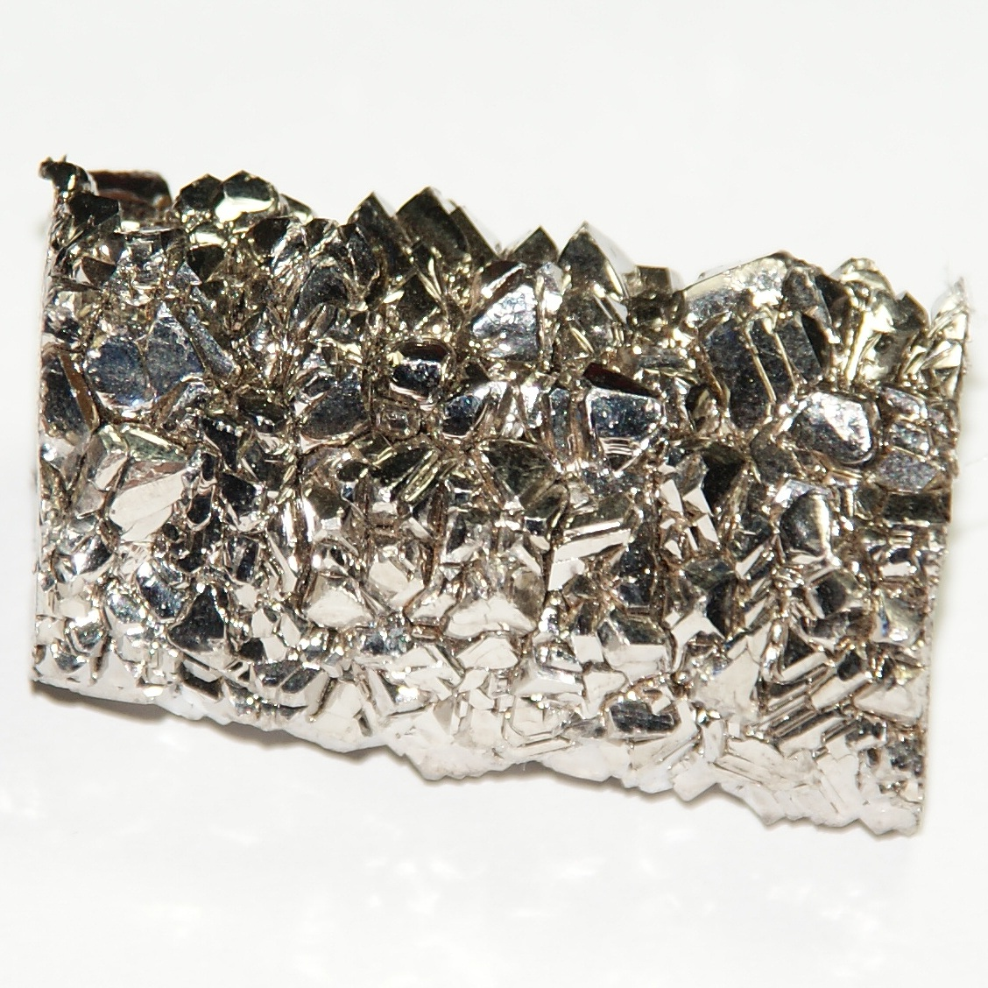
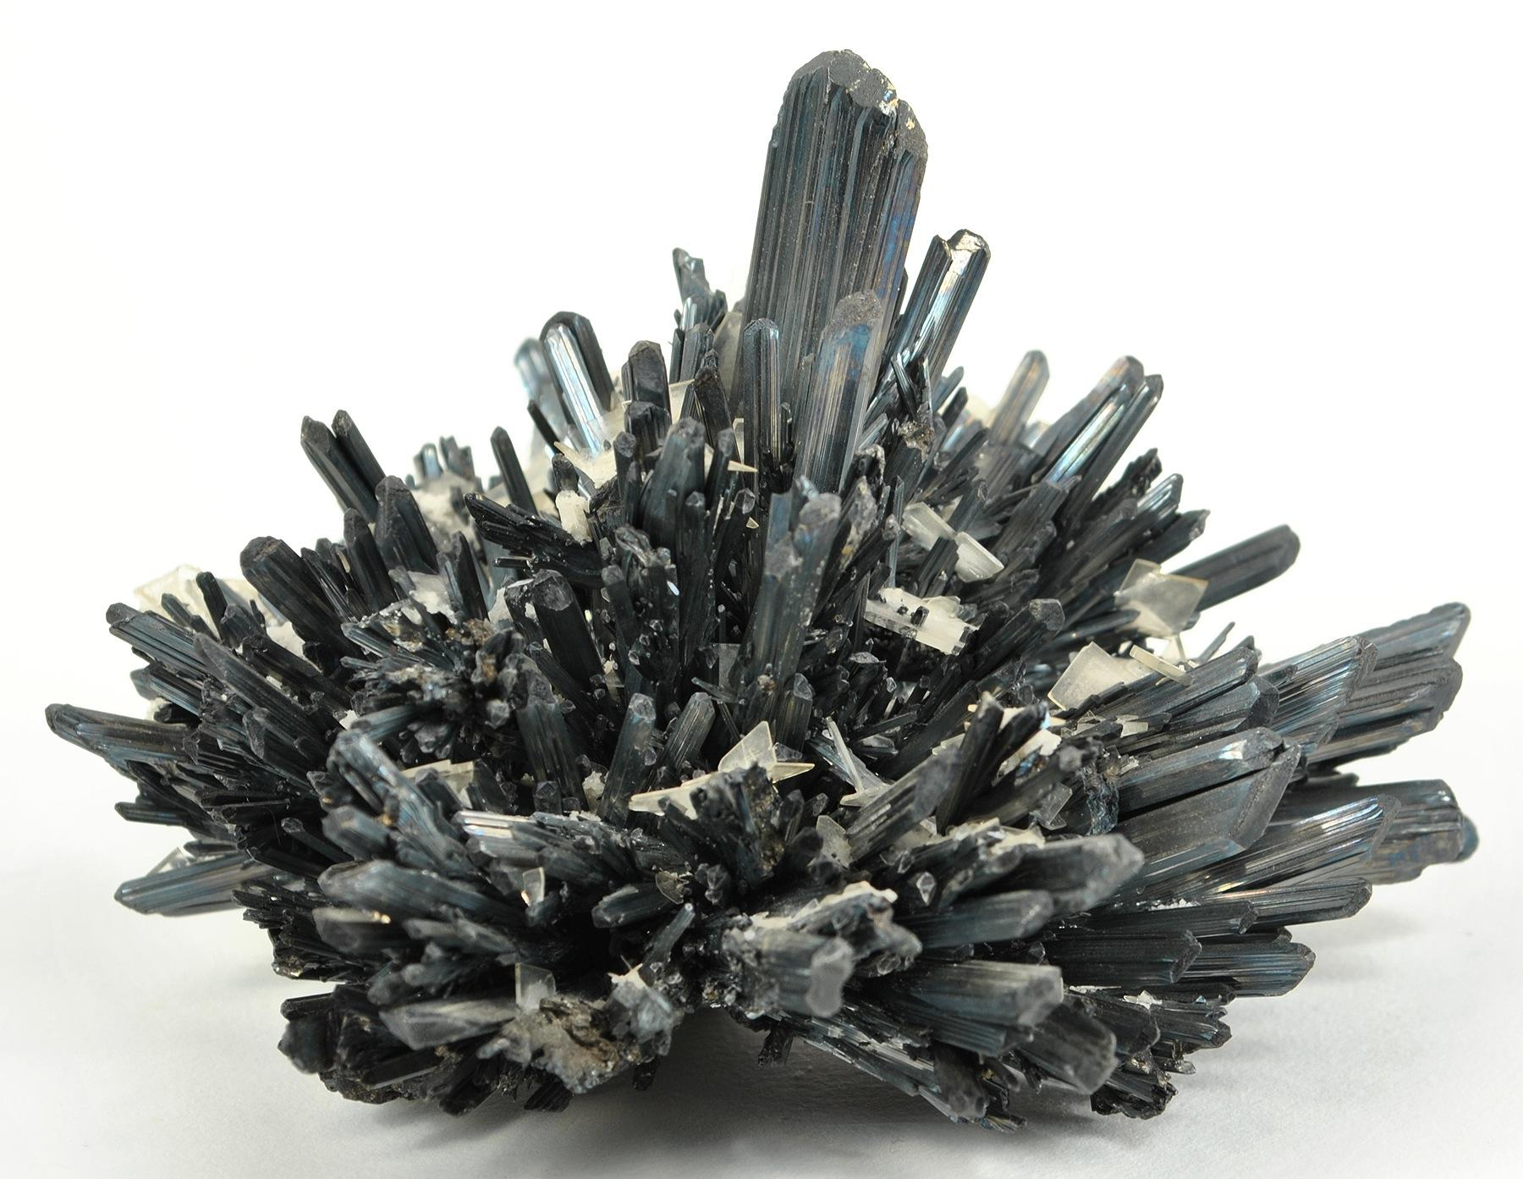
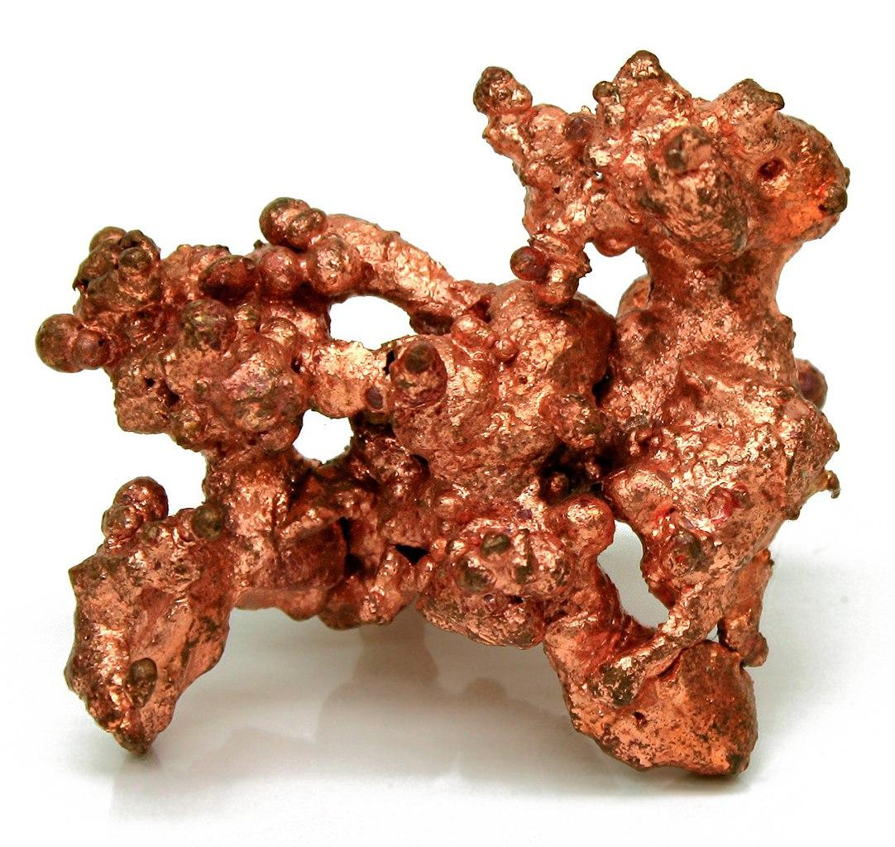
Body of a Computer
The body of a computer is made of titanium, iron, copper, and quartz.
Titanium
Iron
Copper

Slide 4

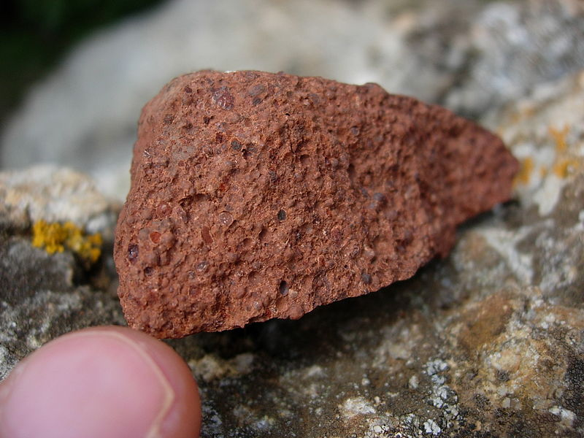
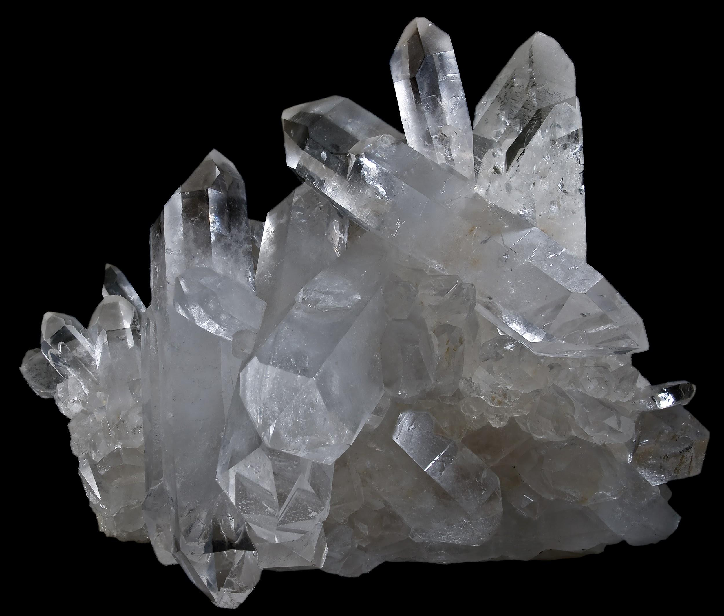
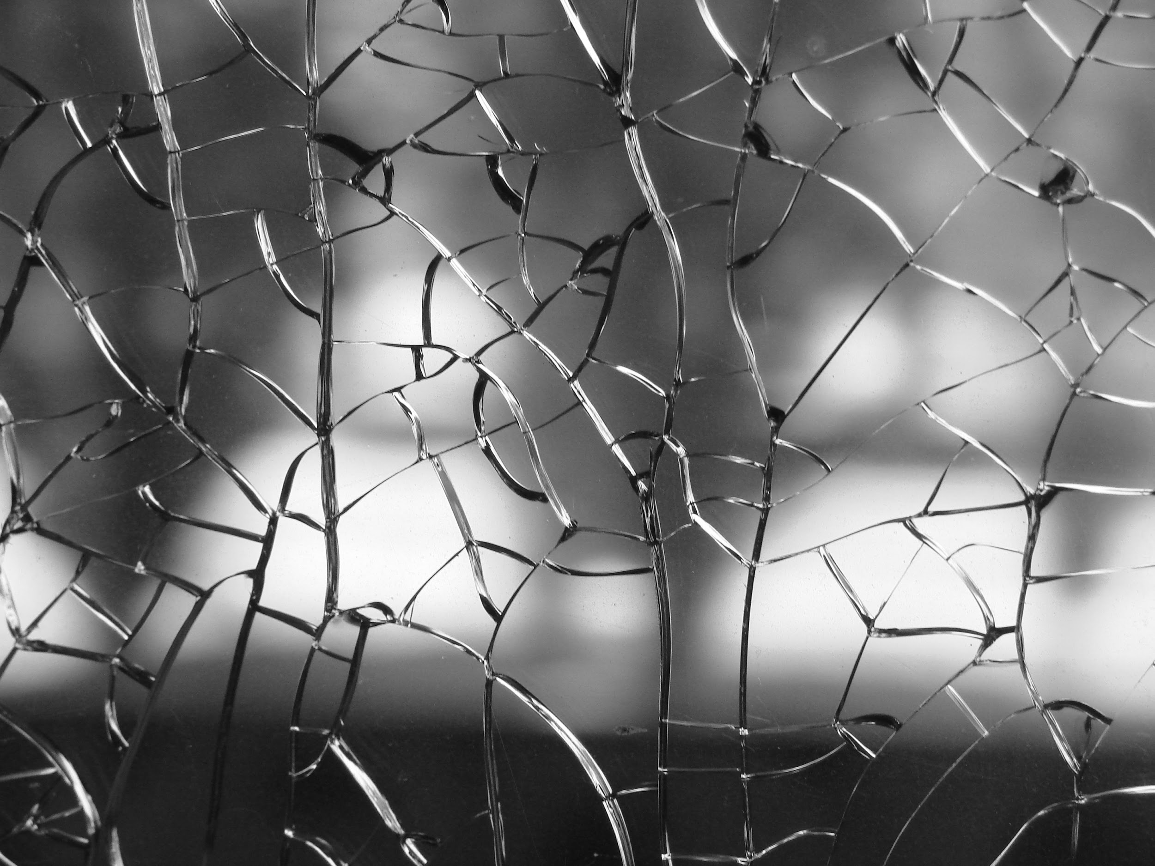
Screen
Bauxite
Quartz
The screen has three types of minerals in it called bauxite, glass, and quartz.
Glass

Slide 5
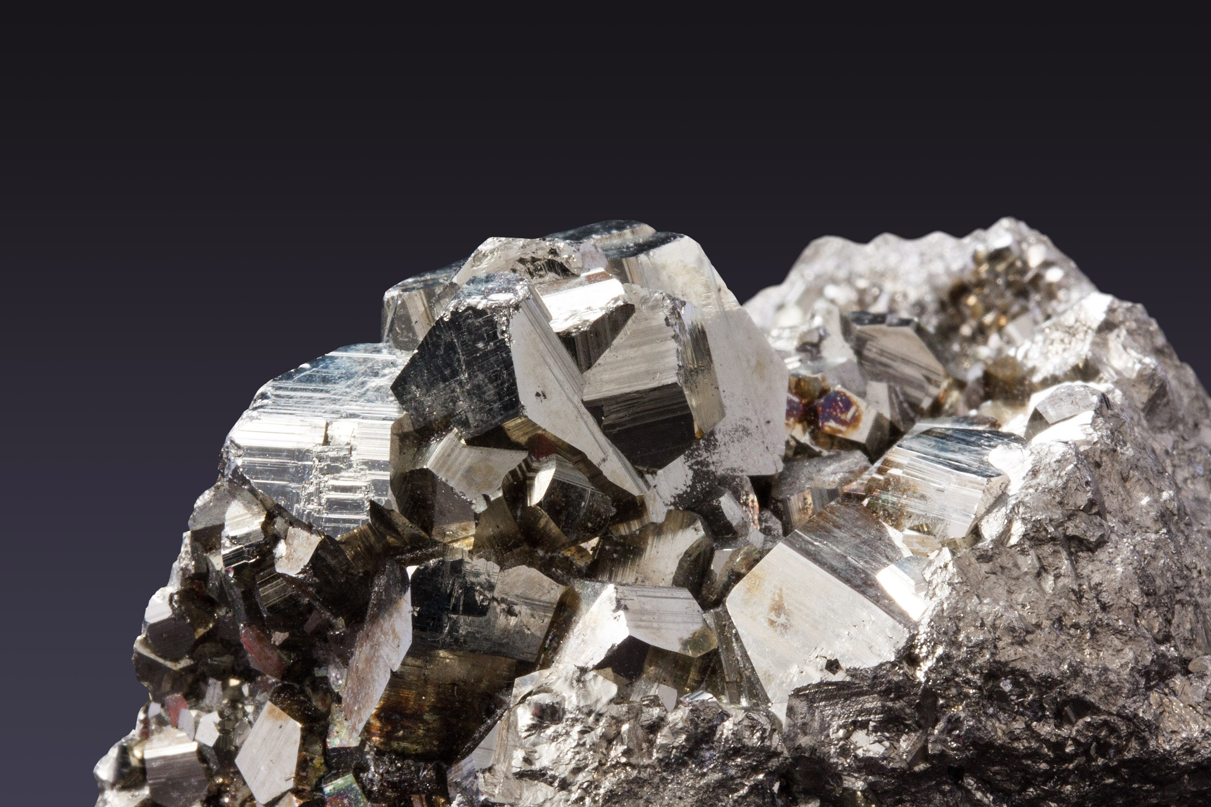
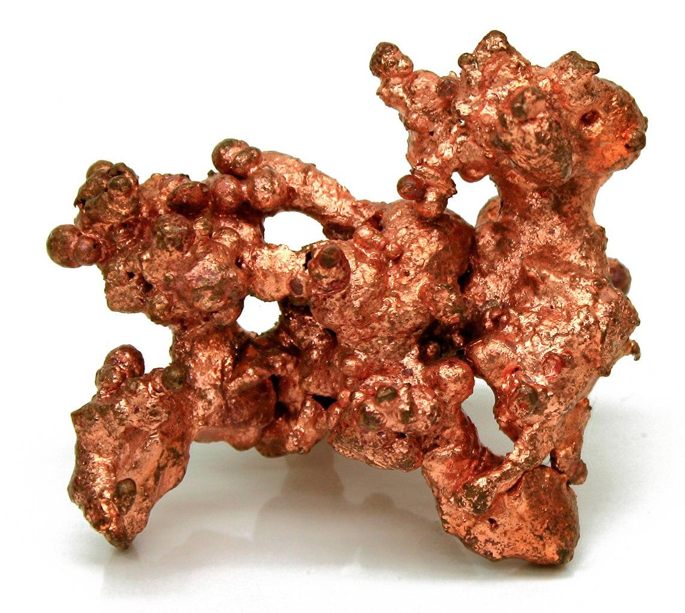
About The Minerals and Rocks
Iron
Copper
Titanium
Found:Canada,Brazil,South Africa. ron is the most widely used metal on Earth. Iron is used to make steel. Steel is used to make buildings, bridges, railroad tracks, vehicles of all kinds, and countless other products.
Found: China, Japan, Russia. Titanium is a really strong material so it can only melt at 1,668 Celsius!.it is a very light but strong material. Titanium is 40% lighter than steel. Can you believe it!
Found: Canada, Chile, and USA .Copper is a chemical element with the symbol Cu (from Latin: cuprum) and atomic number 29. Copper was the first metal to be used by humans.

Slide 6
Motherboard
In the computer metals contained in PC's commonly include aluminum, antimony, arsenic, barium, beryllium, cadmium, chromium, cobalt, copper, gallium, gold, iron, lead, manganese, mercury, palladium, platinum, selenium, silver, and zinc. Most of the minerals in the computers come from the motherboard in the computers. We will only explain some of these minerals.

Slide 7
Keyboards, and Batteries
The metals contained in PC's commonly include aluminum, antimony, arsenic, barium, beryllium, cadmium, chromium, cobalt, copper, gallium, gold, iron, lead, manganese, mercury, palladium, platinum, selenium, silver, and zinc. We will also only explain some of these minerals.
Cobalt and electric vehicle batteries
Cobalt, a bluish-gray metal found in the Earth's crust, is one of today's preferred components used to make the lithium-ion batteries that power laptops, cell phones, and EVs.

Slide 8
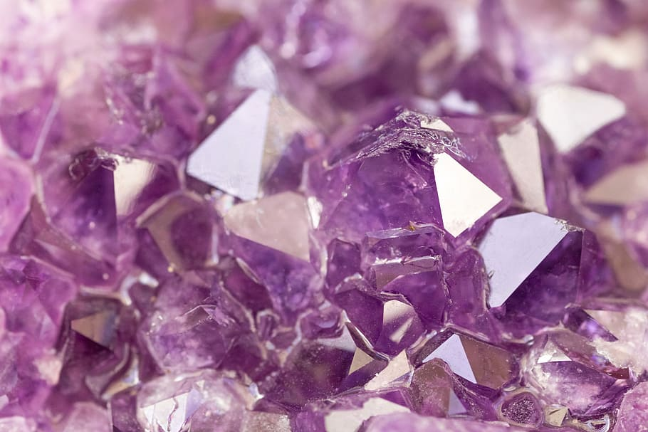
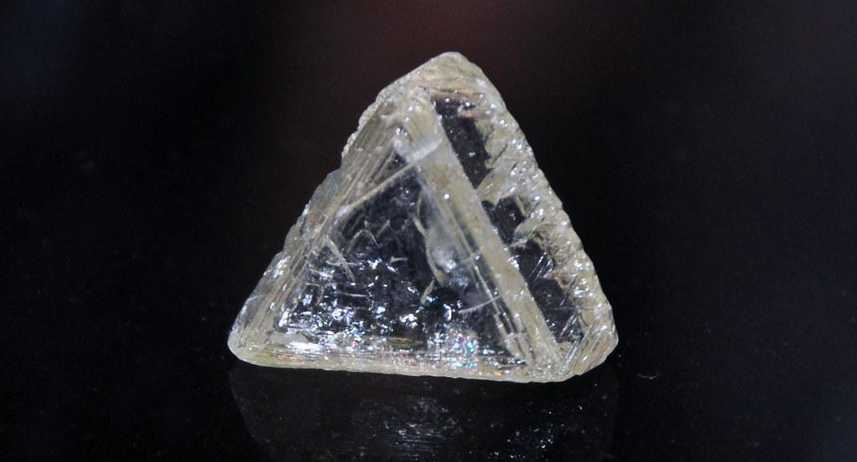
About The Minerals and Rocks
Amethyst
Found: Argentina,Bolivia, India. Amethyst is a purple variety of quartz and owes its violet color to irradiation, impurities of iron and in some cases other transition metals, and the presence of other trace elements, which result in complex crystal lattice substitutions.
Diamond
Bauxite
Glass
Found: Canada, Botswana,
and USA.What is inside Diamond,The inside of a diamond usually has inclusions in it. Either dark parts of carbon material or parts of other minerals in it. It can also have crystals and cleavage marks inside too. The majority of diamonds have this.
Found: China, Australia, Brazil and more! Bauxite is formed from a reddish clay called laterite.
Found: China,USA,
Germany.Did you know that if you melt sand you will get glass.

Slide 9
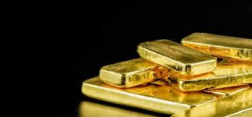
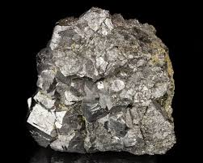
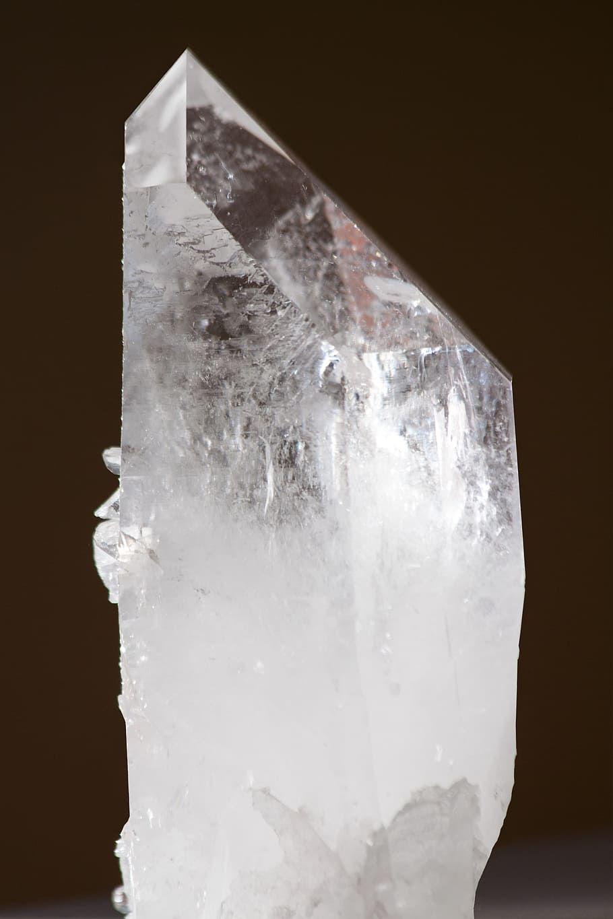
About The Rocks and Minerals
Silicon
Gold
Found: China, Canada, and Peru. Gold is formed from magma. When the magma flows through the mud and burns the rock then the atoms in the rock turns into a hard material called metal then it gets its colour gold.
Silver
Quartz
The largest producers of quartz are USA, and Brazil. Quartz is a mineral composed of silicon and oxygen atoms.
Found: Russia, Canada, and Australia . What is inside silver, “well” pure silver is only 0.1% copper. Can you believe it.

Slide 10
Websites
In our project we used Wikipedia, and Google, Britannica School Elementary.

Slide 11

We Hope You Enjoyed !!!

