Slide 1
Brass Door Knob
By: Levi G.

Slide 2
Brass
Door knobs are usually made of brass. Brass is an alloy of copper and zinc. Alloys are multiple metals combined, or metals with other elements. Brass is made when copper and zinc are heated, until the zinc reacts with the copper to create brass. India produces the most brass in the world. In canada, brass is made in Toronto, Ontario. Brass does not rust, and it’s melting point is 930℃. Brass is conductive, which means electricity can pass through it.

Slide 3
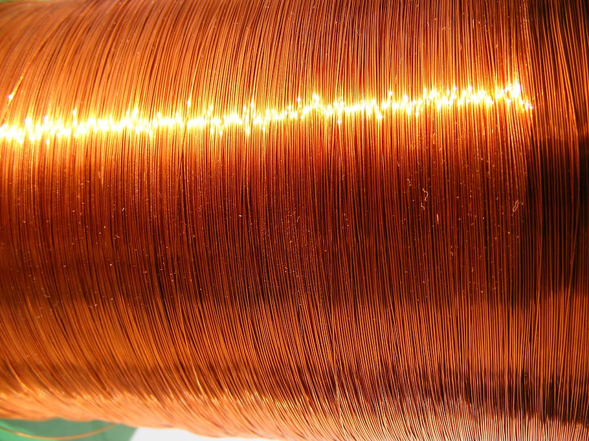
Copper
Remember how Brass is an alloy of copper and zinc? Well now you get to learn about those! Yay… Anyways, copper is diamagnetic, which means magnets retract it. Copper is found in most coins, and it’s melting point is 1085℃ so you’d need a very hot fire to melt your penny’s in, but pennies aren’t pure copper… but that’s for a different time. Copper is mined, not manufactured. With iron, copper makes red blood cells in your body,and helps maintain the tissues in blood vessels. Ontario and BC produce the most copper in canada. Copper is well known for it’s high conductivity and it’s use in wires.

Slide 4

Zinc
It’s zinc’s turn! Zinc is also known as calamine ore. Zinc’s boiling point is 419.5℃, and boils at 907℃. It has many uses in the body. It is in cells all over the body, helps fight bacteria and virus’s, and the body needs it to make protiens and DNA. Manitoba mines the most zinc in Canada. Zinc is also mined, not manufactured. You remember that zinc is used as an alloy in brass, but it is also used as an alloy in alluminum and others.

Slide 5
All websites used
Wikipedia
www.madehow.com
www.worldcoppersmith.com
www.investingnews.com

Slide 6

Thank You For Watching This Presentation
I Hope You Liked It

